Slide 1
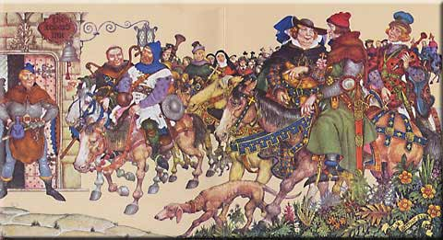
The Canterbury Tales by Geoffrey Chaucer

Slide 2
Geoffrey Chaucer (c. 1343-1400)
Dominant literary figure in the 14th century
“Father of English Literature”
Life experiences
--child of wealthy wine merchant
--page in a royal household
--spoke French, Latin, & Italian
--Soldier & diplomat
--member of Parliament

Slide 3
Geoffrey Chaucer and
The Canterbury Tales
lived and wrote around 1385 A.D.
planned many more tales, but did not complete the proposed 120 tales before his death
wrote about all classes in The Canterbury Tales to give us a glimpse of English society at the time

Slide 4
Geoffrey Chaucer and
The Canterbury Tales (cont.)
He went against tradition—should have written in French BUT he wrote them in Middle English
“Father of the English Language” because he defied rules/law and wrote in the people’s language

Slide 5
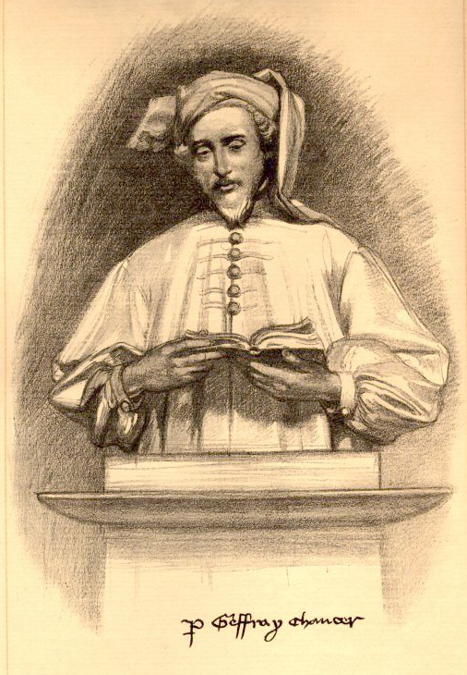
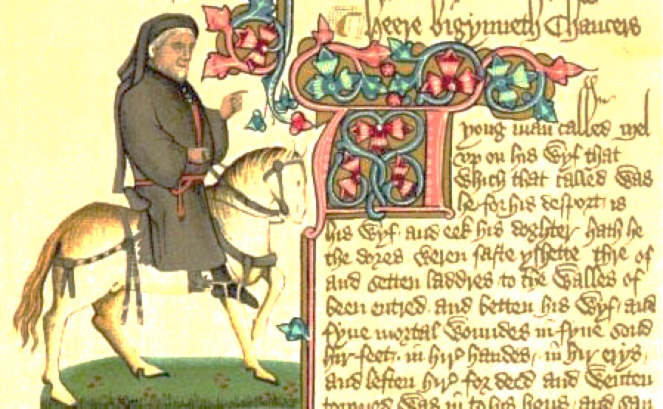
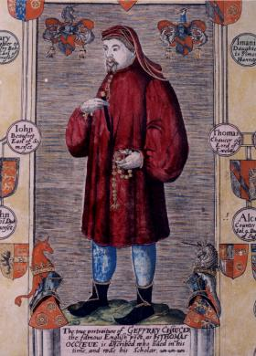
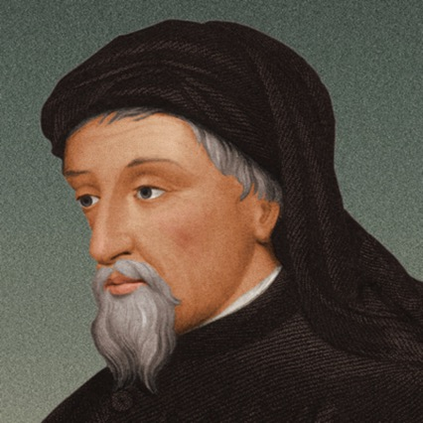
Chaucer Images

Slide 6
The Middle Ages
Background
Hierarchy – Class Structure During Chaucer’s Time
Nobility/Ruling Class - Knight and Squire
Clergy - Monk, Friar, Prioress, Parson, Summoner, Pardoner
Middle Class – Merchant, Doctor, Student, Wife of Bath
Peasants – Miller, Plowman, Skipper

Slide 7
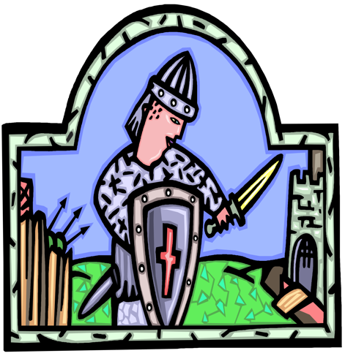
Knight’s Code of Chivalry
A knight must:
1. Be true to his God and
a defender of the faith.
2. Be true and loyal to his
lord and king.
3. Be true to his lady.
4. Be humble and modest in
daily actions.
5. Be brave and fierce in
war and adversity.

Slide 8
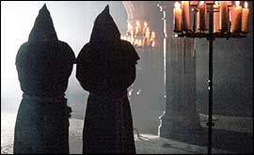
Code of the Clergy
A member of the clergy must:
1. Be chaste and pure.
2. Be devoted to God.
3. Obey God and Biblical
law.
4. Take vows of poverty.
5. Achieve heavenly reward through earthly denial.

Slide 9
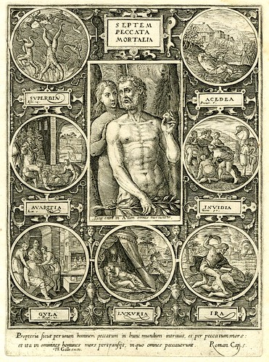
Seven
Deadly
Sins
• Pride
• Envy
• Gluttony
• Sloth
• Lust
• Avarice
• Wrath

Slide 10

Moral Virtues (opposite of sins)
Moderation
Generosity
Diligence
Love
Modesty
Humility
Forgiveness

Slide 11
Chaucer’s Canterbury Tales
Takes representatives of English society on a pilgrimage to Canterbury Cathedral
Pilgrims—each has speech and tale that matches a real person during his (Chaucer’s) time

Slide 12
Chaucer’s Canterbury Tales (cont.)
30 characters representing all social classes
--Chaucer, as a parody of himself, is one of the pilgrims
--Although fictional, does have realistic settings and occupations
*Tabard Inn
*Canterbury & Canterbury Cathedral
*Shrine of Thomas Becket
Chaucer’s tone: IRONIC

Slide 13

The Prologue
Thirty pilgrims are on their way to Canterbury to pay homage at Becket’s tomb.
Each agrees to tell two tales on the way to the shrine and two tales back.
The winner will receive a supper paid for by all.

Slide 14
List of 30 Pilgrims
Narrator – line 20
Knight – line 43
Squire – line 81
Yeoman – line 103
Prioress (+ 3) – line 122
Monk – line 169
Friar – line 212
Merchant – line 280
Oxford Cleric – line 295
Serjeant at Law – line 319
Franklin – line 341
Guildsmen – (Haberdasher, Dyer, Carpenter, Weaver, Carpet-Maker) - line 371
Cook – line 390
Skipper – line 398
Doctor – line 421
Wife of Bath – line 455
Parson – line 488
Plowman – line 539
Miller – line 561
Manciple – line 585
Reeve – line 605
Summoner - line 641
Pardoner – line 689

Slide 15
Assignment:
Pilgrim Presentations
Read the description of your pilgrim in the prologue
Present a PowerPoint chart to the class with your findings
TWO SLIDES
Any format, font, style you like…
Must contain the following information:

Slide 16
Slide One
Title (pilgrim’s name)
Picture of your pilgrim (according to description given)
Specific quotes and phrases that provide evidence of your pilgrim’s
  Physical characteristics, clothing, and accessories
  Words, experiences, personality traits

Slide 17
Slide Two
Social class and why
Inferences (Chaucer’s commentary)
  Specific lines that lead to inferences about your pilgrim
  Does he/she uphold the proper values of his or her social position? Any vices or virtues?
  What is Chaucer criticizing?

Slide 18
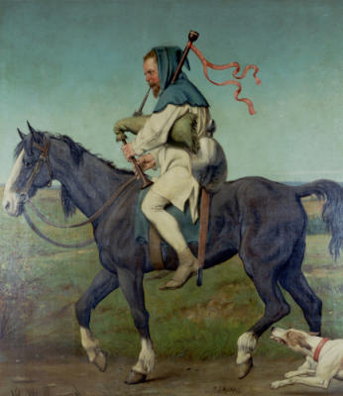
THE MILLER
Example
Physical Characteristics, Clothing, and Accessories
Chap of sixteen stone (561)
Big in brawn and bone (562)
Broad, knotty and short-shouldered (565)
Broad, red beard (568-569)
Wart with red, bristly hair growing on his nose
(571-572)
Black nostrils and mighty mouth (573-575)
Carried a sword and buckler (574) and bagpipes
(583)
Wore blue hood with a white coat (582)
Words, Experiences & Personality Traits
Likes to wrestle (564)
Boastful of his strength (565-567)
Likes to tell dirty jokes (576-577)
Thief and cheater (578-581)

Slide 19
The Miller
Peasant Class
  Supported by a trade
Inferences
  Chaucer compares him to a sow and fox suggesting he is wild and rough (568, 571)
  Chaucer compares mouth to a furnace door, suggesting he is uncouth and foul-mouthed (575)
  By stating he was a “master-hand” at stealing, Chaucer infers the miller has cheated customers his whole life (578). Major vice!
  Through his depiction of the miller as bawdy and belligerent, Chaucer is critiquing the peasant’s low station in life

